Slide 2
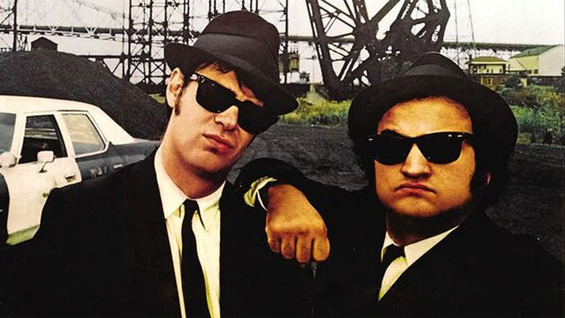

Slide 3
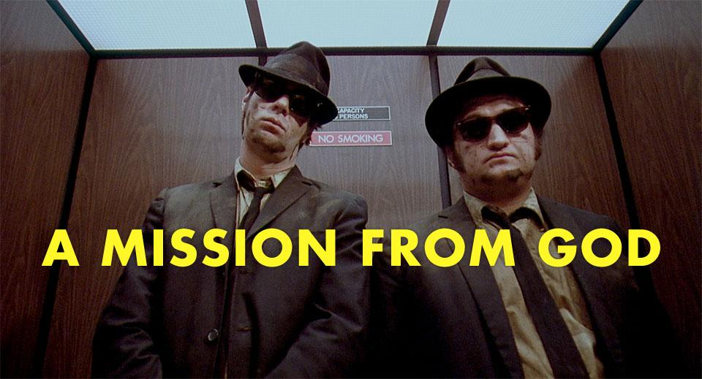

Slide 4
Luke 1:39-56

Slide 5
Fellowship . . .

Slide 6
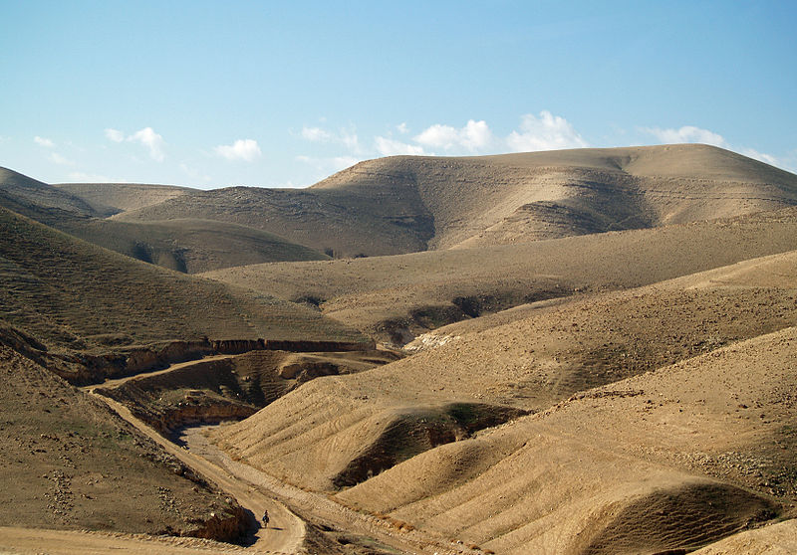

Slide 7
Fellowship . . .
Has cost

Slide 8
What is your Cost Break Point?

Slide 9
Blessing . . .

Slide 10
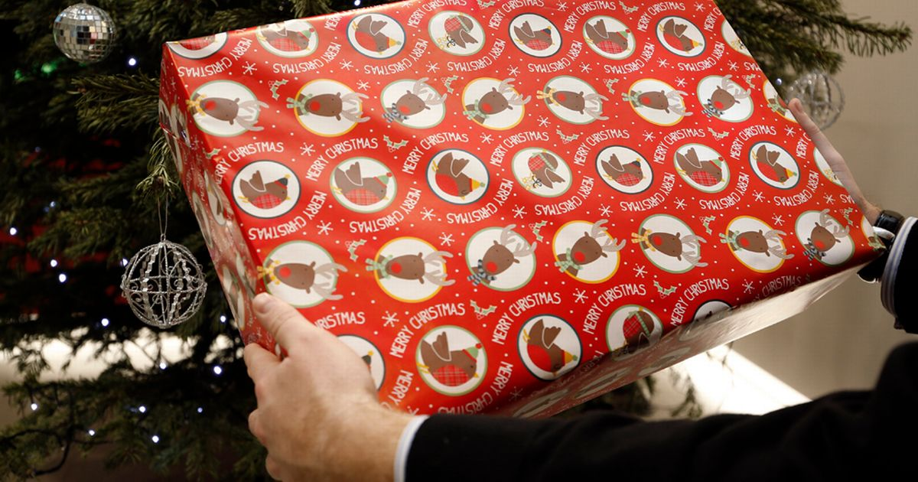

Slide 11
Blessing . . .
Follows Obedience

Slide 12
What is God Asking You to Obey?

Slide 13
Worship . . .

Slide 15
Worship . . .
Is Mission Fuel

Slide 16
Does Your Worship Compel you to Mission?

Slide 17
Mission . . .

Slide 19
Mission . . .
Is God Sized

Slide 20
What is Your Mission from God?

