Slide 2
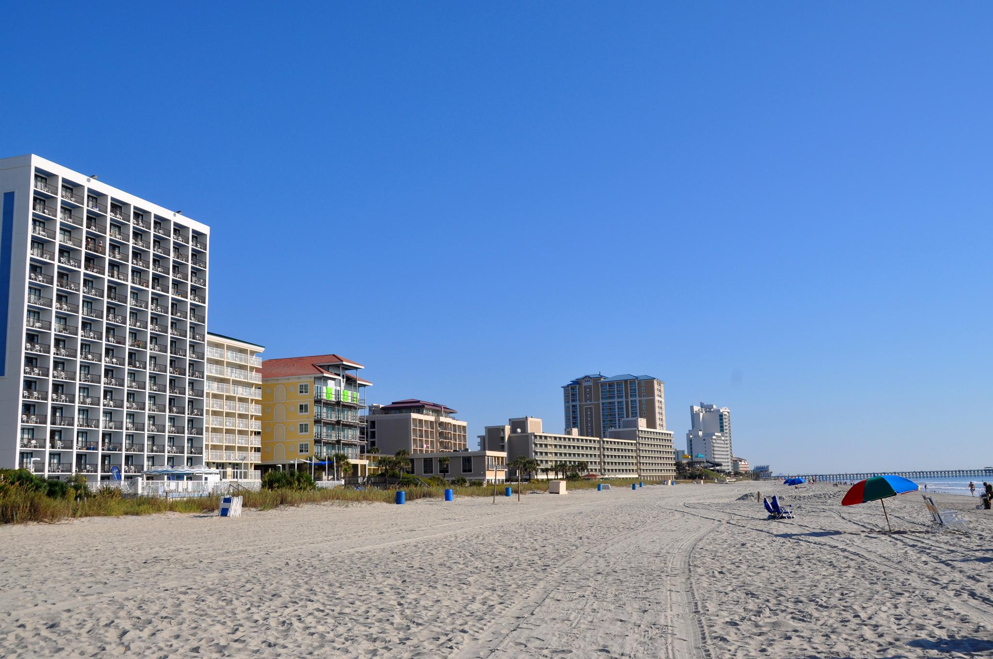

Slide 3
John 4:43-54

Slide 4
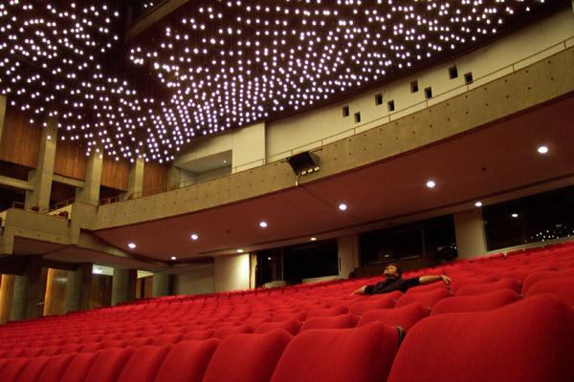
Are Looking for a Savior
Or a Show?

Slide 5
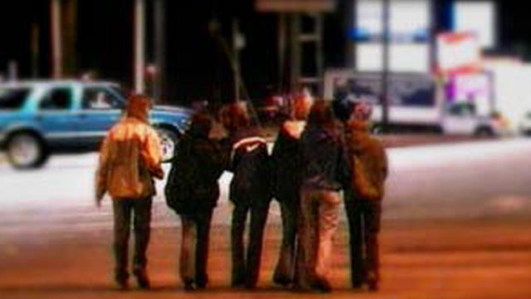

Slide 6
Are Looking for a Savior
Or a Show?

Slide 7
Are You Ready For Imperfect People?

Slide 8
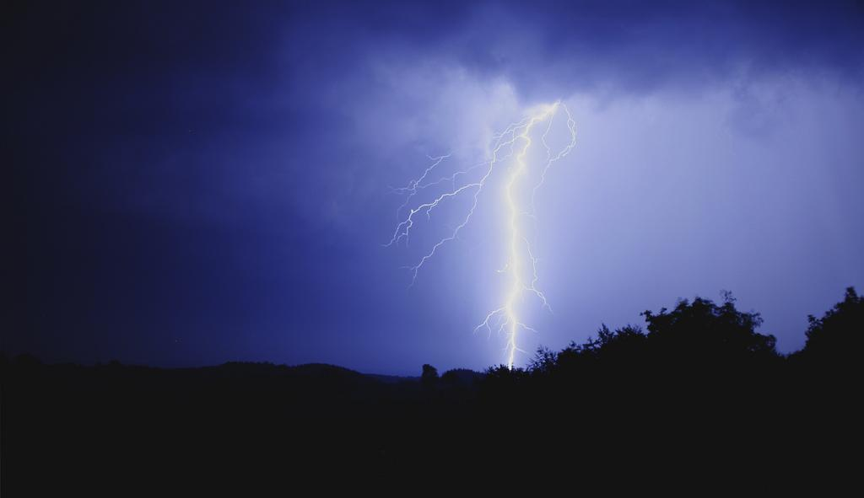
Are God’s Mighty Deeds on Display in Your Life?

Slide 9
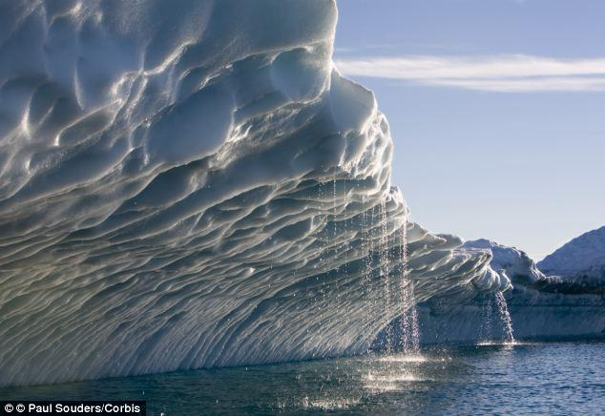
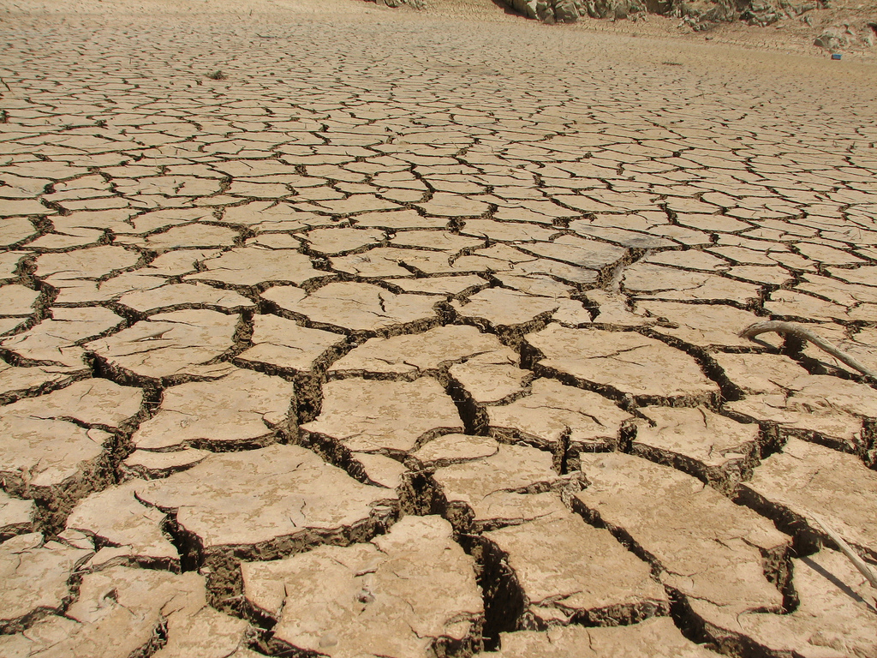
The Same Sun that Melts the Ice Hardens the Clay

Slide 10
Are God’s Mighty Deeds on Display in Your Life?

Slide 11
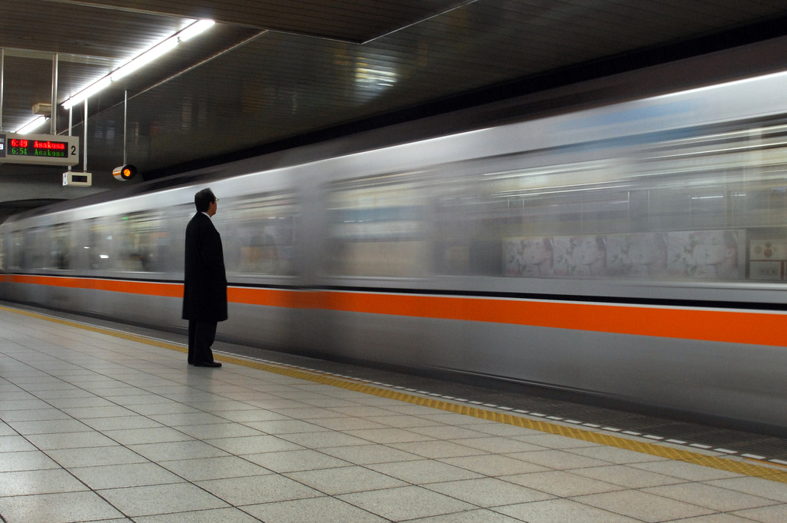
Are You Translating Belief Into Action?

Slide 12
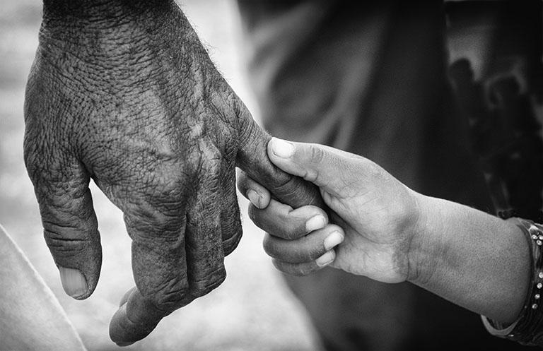
NEXT STEPS:
Have a Spiritual Conversation this week.
Notes:
What do you need to do today?

