Slide 4
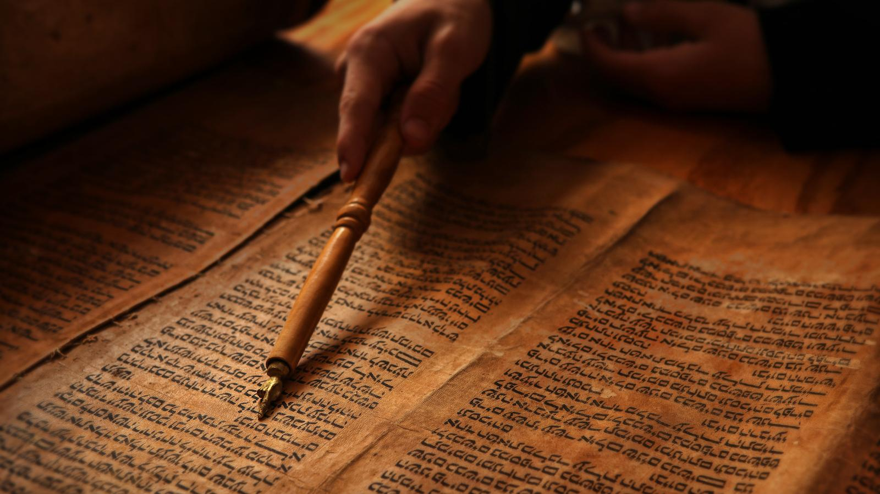

Slide 5
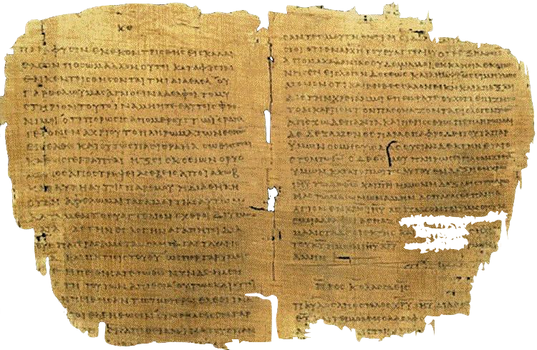

Slide 9
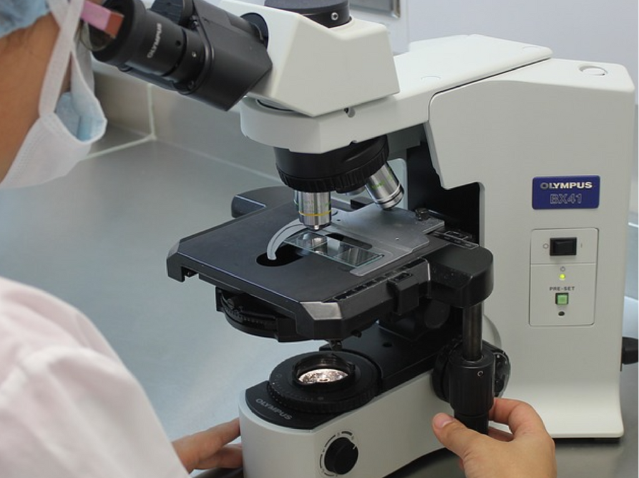

Slide 14
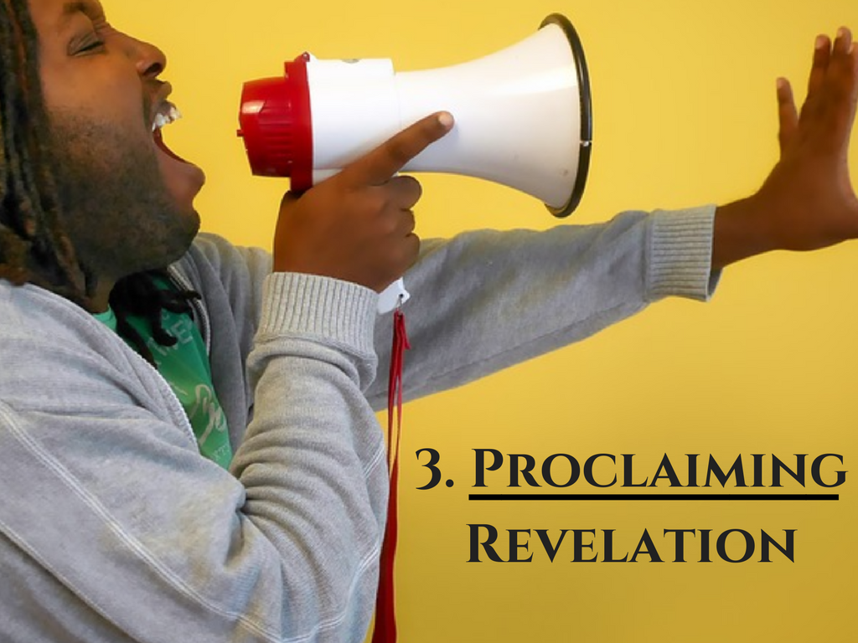

Slide 21
Sermons
Sunday School
www.christianuniversity.org
www.biblicaltraining.org

